Slide 1
Introduction to Git & GitHub
Computing Society

Slide 2
What is Git?
What is GitHub?
How to use Git & GitHub
How it can benefit you

Slide 3
Install Git
Linux
sudo apt get-get install git
Windows & Mac
https://git-scm.com

Slide 4
Git is a version control system.

Slide 5
GitHub is a repository hosting service built on Git

Slide 6
Git & GitHub are separate,
but linked.

Slide 7
GitHub is the industry-standard tool for collaborating on and sharing code. It’s popular among software developers, project managers, designers, and students for its flexibility and control. This course introduces GitHub and Git, the version control system that GitHub is built upon. Instructor Aaron Stewart, a training content specialist at GitHub, explains the benefits of version control, how to navigate GitHub and the command line, how GitHub and Git are related, and the best practices for communication and collaboration on GitHub. Aaron also reviews the most common tasks, such as branching, commits, and pull requests, and shows you how to create a simple local project and move it to GitHub to share with your team. Once you have completed the course, you should be able to immediately start using Git and GitHub to manage your own code.

Slide 8
EssayFinal.docx
EssayFinal2.docx
EssaySuperFinal.docx
EssaySuperFinalRevised.docx
EssayAbsoluteFinalHandIn.docx
Notes:
Does this look familiar to anyone?
It’s a common situation where the development of a file can get mixed and jumbled up into several variations
Although Git doesn’t work well with binary files like .docx, for plain text files of the sort you use for writing programs and scripts, it removes these sorts of problems completely

Slide 9
Version Control
A system that records changes to a file or set of files over time.
Allows you to revert files to previous states, or revert the entire project back to a previous state
Compare changes over time
See who made which changes when
Enables better collaborative development

Slide 10
Other version control systems
Subversion (SVN)
Concurrent Versions Systems (CVS)
Preforce
Mercurial
Bazaar
Etc.
Notes:
Originally, CVS handled conflicts between two programmers by only allowing for the latest version of the code to be worked on and updated. As such, it was a first come, first serve system where the user must publish changes quickly to ensure that other users haven’t beat them to the punch.
Now, CVS can handle branching projects so the developed software can diverge into different products with unique features and will be reconciled at a later time.
The CVS server runs on Unix-like systems with client software that runs on multiple operating systems. It is considered the most mature version control system because it has been developed for such a long time

Slide 11
Notes:
26 % SUBVERSION

Slide 12
Master Branch
Similar to a timeline, keeping track of all your changes
Notes:
Pretty much the timeline, as we make changes they're going to appear on here, but you don’t necessarily want to put them on the live version of the project in case you make a mistake, or you make some changes and I make some changes and everything gets muddled up.

Slide 13
Branching
Notes:
So, the reason why Git is so widely used in industry is because has a useful implementation called ‘Branching’ . We can create a branch which is going to make a copy of the whole website to your own branch – the master version is still untouched but you have a copy of the it [transition] and you can make some changes and do whatever you want to do and save the changes and just like our master branch keeps track of changes, so does our branch, its keeping track of all the saves and changes
Cool thing about git is while all this is going on, someone else can be making their own branch which is following the master version not the changes you’ve made. Or you could even be doing multiple branches at once in your own solo projects

Slide 14
Pull Requests
Notes:
So once you’ve done all your stuff and you want it to be implemented into the live version of the project, you make a pull-request.
As simple as it sounds, you want to pull all your changes into the master branch. If you’re in a large team, chances aree someone else will be approving these pull requests
It’s only going to review the changes you have made comparative to the master branch.
So if the top person made changes to the images and the bottom person only changed the text, everything will be pulled together fine because it’s only reveiing the changes. If the top person made changes to the images ad the bottom person made changes to the images, its going to recognise in the comparison that there’s a conflict. And whoever is managing the pull requests (which could be you) will have to review the conflicts
It is possible to branch off branches
Can always roll back

Slide 15
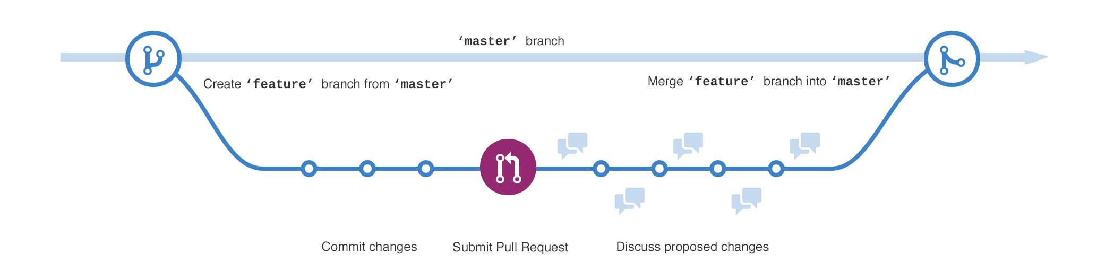

Slide 16
Commits
When a pull-request is approved, the changes to the master branch are committed.

Slide 17
Why Git is so attractive…
Focus on content, not files
Opt-in, not out
Open-source
Distributed, not centralised
Conversational
Notes:
Git is focused on content; it’s a level of precision deeper than others, it can follow the move of source code from one file to another over a period of time. Because it’s looking at the content of each file, not just the directory contents.
Explicitly opting in which files are included in the next commit avoids wrong files accidentally being included in commits which could ruin something.
Git is very efficient with its transfers which makes it more pleasant to send large amounts of data over continents etc.

Slide 18
Notes:
DEMONSTRATION

Slide 19
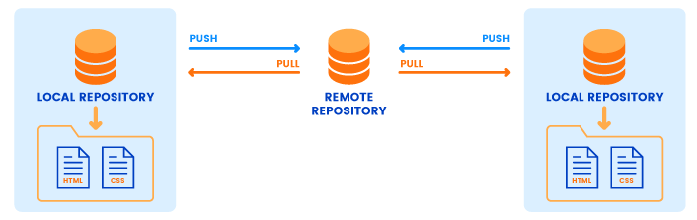
GitHub
https://rubygarage.org/blog/most-basic-git-commands-with-examples
Notes:
Github is useful for providing a midpoint between local repositories on your computer and other peoples.
CREATE A REPO ON GITHUB

Slide 20
Rinse & Repeat (for Simple Projects)
If you add any new files to the project, run “git add [filename]” or “git add *”
To commit any changes, run: git commit -m "Commit message“
Then to push back up to GitHub, run: “git push” or “git push origin master”
If we make changes on another machine, the GitHub Website or are unsure anyone has made any changes to the master branch, we can run “git pull” to pull any changed/added files to the repo’

Slide 21
The Easier Method:
GitHub Desktop

Slide 22
Notes:
DEMO GITHUB DESKTOP

Slide 23
Forking (Cloning in Git)
Creating a new branch, but by cloning someone else's repository (which you will likely not have permission to commit changes to)
“git clone [url]”
Although this can also be done completely via the GitHub web interface

Slide 24
Student Developer Pack - GitHub Education
https://education.github.com/pack

Slide 25
Computing
Society

